Slide 1


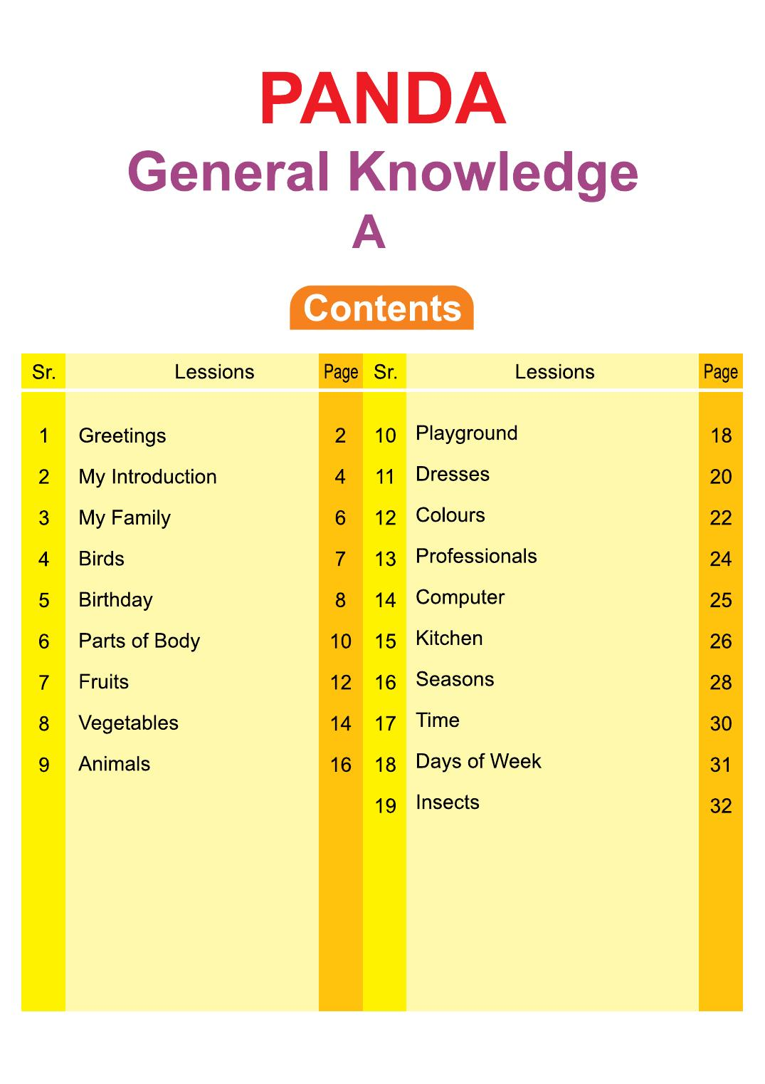
Panda General Knowledge Book
Playgroup • Age 3+
An activity-based early-years book from the Panda Series.
A Project of Azhar Publishers & Book Factory

Slide 2
i
What's Inside
Panda General Knowledge Book Playgroup • Age 3+
1
Greetings, my introduction and my family
2
Birds, animals, fruits and vegetables
3
Parts of the body and the five senses
4
Colours, dresses and professionals
5
Playground, kitchen and the computer
6
Seasons, time, days of the week and insects

Slide 3
★
Purpose & Classroom Support
Builds everyday awareness and vocabulary — about themselves, their family and the world around them — through big, friendly pictures and simple activities.
“
Every book comes with
1
2
3
Teacher's Lesson Plan
Practice Papers
Digital Interactive Version
A 40-week lesson plan that guides teachers, day by day.
Monthly tests and term exam papers for children to attempt.
An interactive flipbook and digital exercises for engaging, screen-based practice.
A Project of Azhar Publishers & Book Factory

